Slide 1
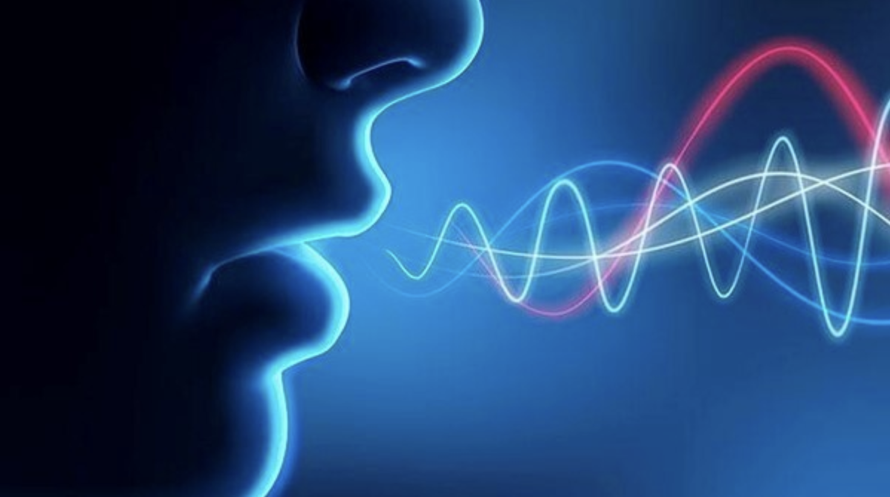
Audio Deefakes and Detection Technology
By Young Hoon Kim

Slide 2
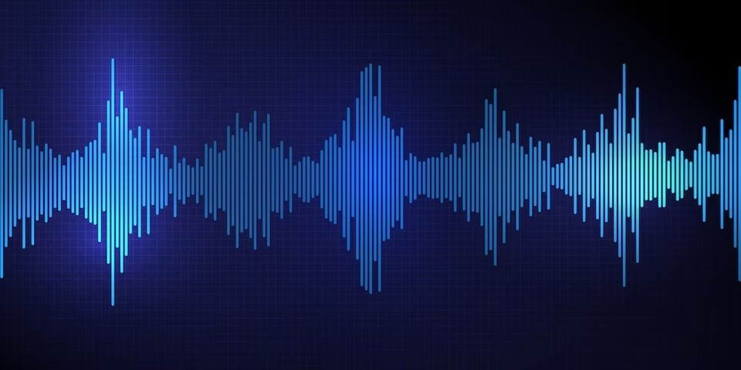
Contens
Summary of Audio Deepfakes Technology
Summary of Deepfake Audio Detection Technology
Generalization Methods
Future Directions
Conclusions

Slide 3
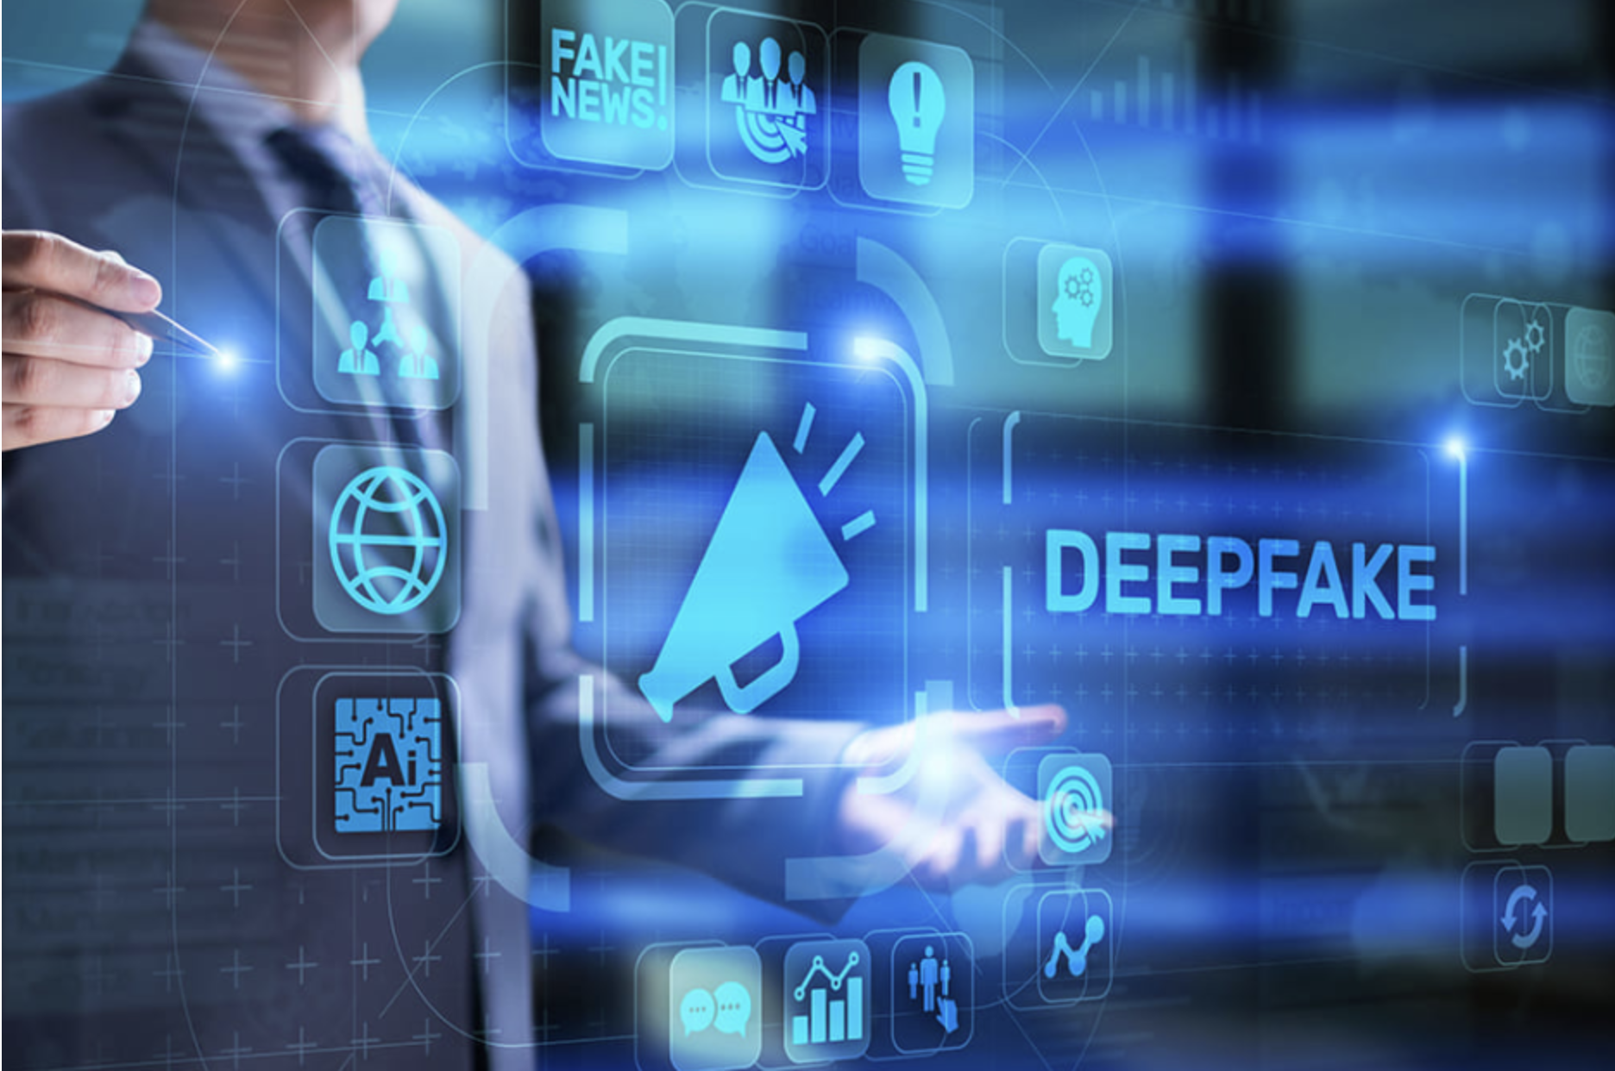
Summary of Audio Deepfakes Technology
Non-AI generated : Replay attacks
Replaying the recoding of a target speaker’s voice
Far field detection replay attacks : The test segment is a far field microphone recoding of the victim, replayed on a phone handset with a loudspeaker
Cut and paste detection attacks : Being made by cut and paste short recodings to fake the sentence required by a text-dependent
Attack : Threat to speaker verification system because of low-cost, also can be used against voice assistants
Defense : Text dependent speaker verification and a current technique that detects end-to-end replay attacks by using deep convolutional networks

Slide 4
Summary of Audio Deepfakes Technology
AI-generated audio fakes : Speech Synthesis (TTS : Text-to-Speech)
Analyzing the text and making the speech sound in line with text inputted using the rules of linguistic description of the text, also its advantages(human like, offering different accents and voices), and configuring(samples of actual voices, speaking rate, pitch, volume, sample rate hertz)
Char2Wav(an end-to-end speech synthesis generation framework)
WaveNet : The explanation of its formula and architecture
The overall structure of WaveGlow, Tacotron 1(end-to-end text-to-speech generative model), Tacotron 2(recurrent seq-to-seq feature prediction network and modified WaveNet vocoder)
Deep Voice3 : encoder, decoder, converter
MelNet(Time-delayed stack, Centralized Stack, Frequency-delayed stack)
Using NN TTS synthesis can make the speech audio not in training, ex. Char2Wav, Baidu 3 Voice, Deep Voice 1, 2, Lyrebird-Descript, WaveNet, Voco, Tacotron 1, 2, WaveGlow, Melnet

Slide 5
Summary of Audio Deepfakes Technology
AI-generated audio fakes : VC(Voice Conversion)
The benefit of VC : Helping speech disorders and using for speakin and hearing aid devices, translation, education, entertainment
Pushing the anti-spoofing capabilities to improve in normal speaker verification systems
GMM(Gaussian mixture model), GANs, CycleGAN, StarGAN-VC, ASSEM-VC, Cotatron-VC

Slide 6
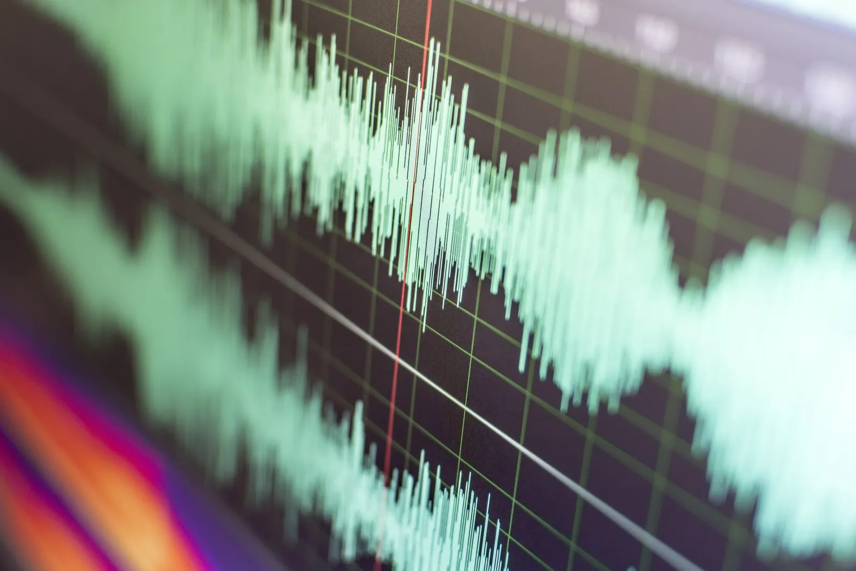
Summary of Deepfake Audio Detection Technology
Front-end
Discriminative Features : Hand-crafted
Short-term Spectral Features : Computed mainly by applying the short-time Fourier transform(SFTF) on a speech signal
Magnitude based : Usefulness for detecting generated speech
Magnitude spectrum : LMS(log magnitude spectrum), RLMS(residual log LMS)
Power spectrum : MFCC(Mel-Frequency Cepstrum Coefficients), LFCC(Linear Frequency CC), IMFCC(Inverse MFCC), LPS(log power spectrum), RFCC(Rectangular filter CC), Cep(cepstrum), LPCC(Linear prediton cepstral coefficient)
Phase based : Being used to discriminate between human and generated speech
GD based : GD(Group Delay), MGD(modified GD), MGDCC(MGD cepstral coeffient)
Other phase : IF(Instantaneous frequency), BPD(baseband phase difference), RPS(relative phase shift), CosPhase(cosine-phase)
Long-term Spectral Features : Capturing long-range information from speech signals
STFT(Short-time Fourier Transform, 단시간 푸리에 변환) based : Modulation : Modspec, Global M / Other : SDC, FDLP, LBP
CQT(Constant Q Transform, 상수 Q 변환) based : Long-term window transform which provides higher frequency resolution at lower frequency, but higher temporal resolution at higher frequencies in contrast to the STFT, CQCC, eCQCC, ICQCC, CQTMGD
HT based : Computing from the analytical signal obtained by the HT, such as mean Hilbert envelope coefficients(MHEC)
WT based : Being derived mainly by performing WT(wavelet transform) on speech signals, MWPC, CFCC, CFCCIF
Prosodic Features : Less sensitive, so complementary information to spectral features, Pitch(fundamental frequency:f0) , Duration, Energy

Slide 7
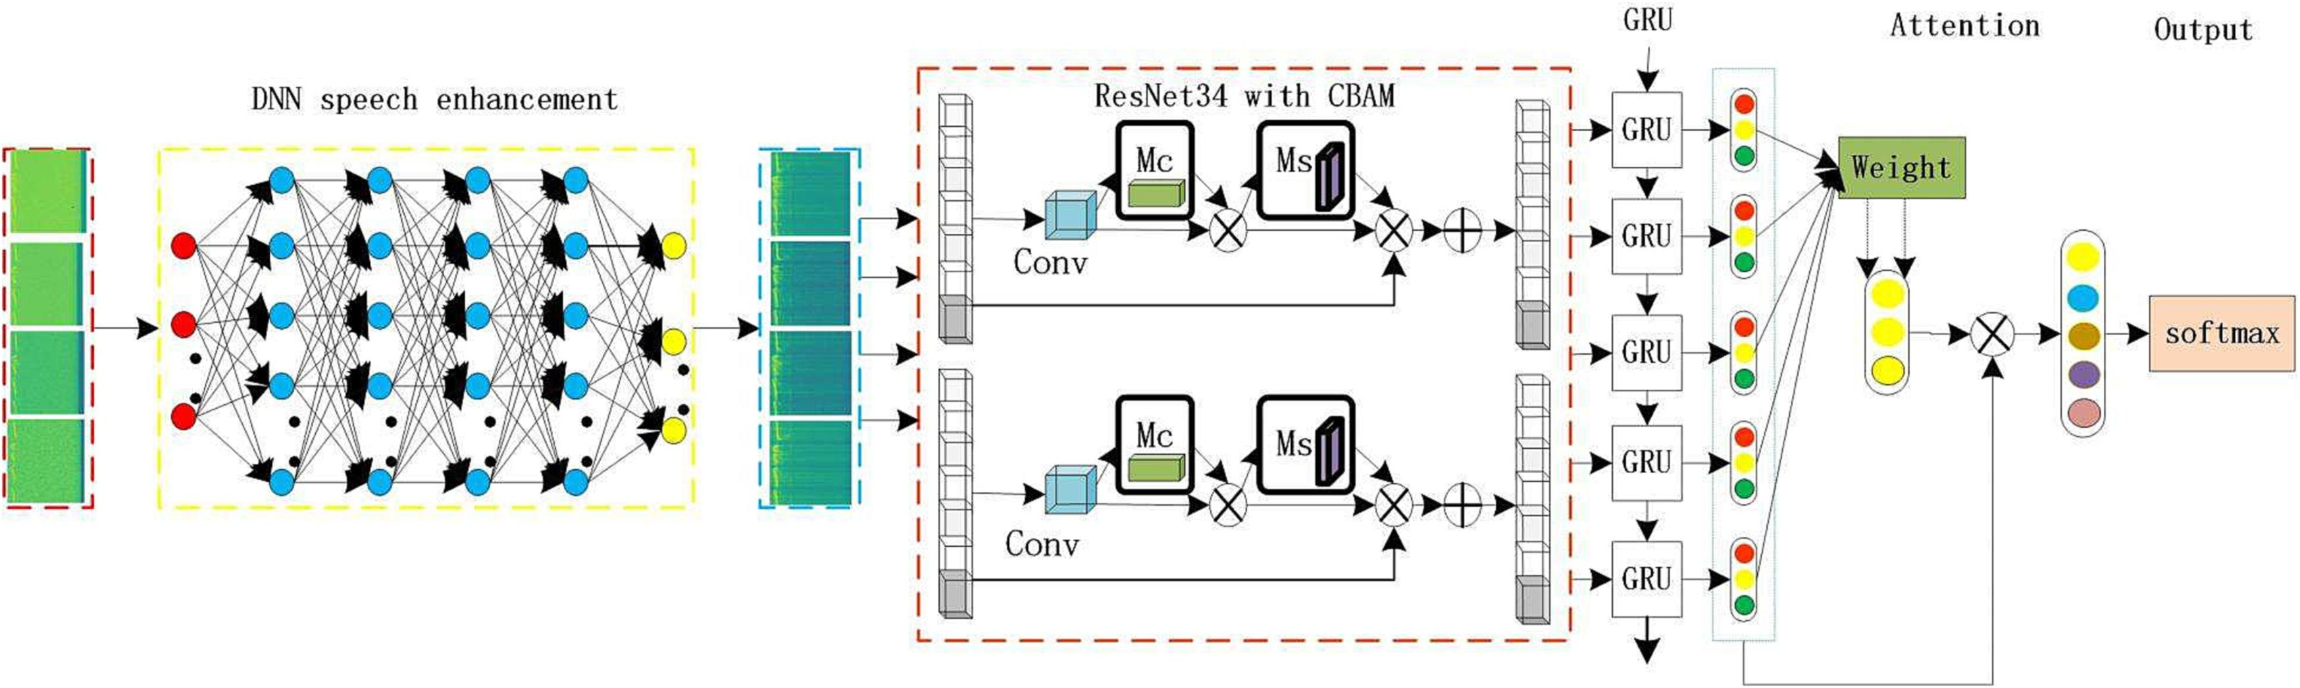
Summary of Deepfake Audio Detection Technology
Front-end
Discriminatives Feautures
Deep Features
Learnable spectral features
Partially learnable : Extracted by training a neural network based filterbank matrix with a spectrogram obtained by applying STFT on a speech signal(FBCC, ConvRBM, nnAudio, FastAudio)
Fully learnable : Learned directly from raw waveforms to approximate the standard filtering process (TD-FBanks, SincNET, RawNet2, LEAF)
Supervised embedding features : Involving the extraction of deep embeddings from deep neural network via supervised training (Spoof, Emotion, Speaker, Pronunciation)
Self-supervised embedding features : Being costly and technically demanding of supervised embeddings, self-supervised embedding is needed(Wav2vec, XLS-R, HuBERT)

Slide 8
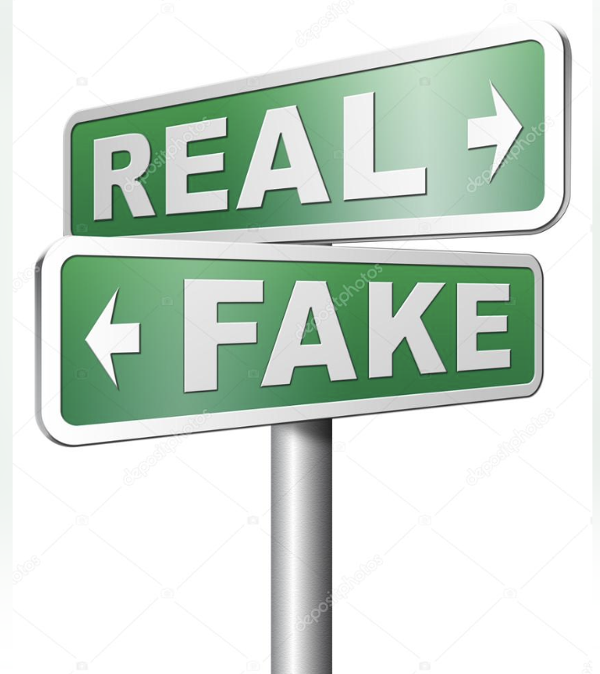
Summary of Deepfake Audio Detection Technology
Back-end : Classification Algorithms
 | Based | A brief account | Algorithms | Advantages | Disadvantages
Traditional Classification |  |  | SVM | Early work, excellent classification capabilities | Restricted by the limited training samples
 |  |  | GMM | Most widely used baseline | Performance needs to be further improved
Deep Learning Classification | CNN | Good at capturing spatially-local correlation | LCNN | Easier to benchmark due to popularity | Deeper networks are difficult to train and result in performance degradation
 | ResNet | Employing a residual mapping | ResNet | Avoiding performance degradation | Limitted generalizabilities to unseen fake attacks
 |  |  | AFN | Enhances feature representations in both the frequency and time domains | Out-of-domain generalizabilities should be improved
 | Res2Net | Improve ResNet's limited generalization against unseen attacks | Res2Net | Enlarging the receptive fields and improve the generalization to unseen fake utterance | Not considering channel relationship
 | SENet | Squeeze-and-Excitation network | SENet | Modelling interdependencies between channels | Deeper networks are difficult to train and result in performance degradation
 |  |  | ASSERT | Combining SENet and ResNet, achieving better performance | Not learning the relationships between neighbouring sub-bands or segment
 | GNN | Learning underlying relationship among data | GAT | Modelling relationships between temporal segments or spectral sub-bands | Not automatically optimize network architectures
 | DARTS | A particular variant of neural architecture known as differentiable architecture search | PC-DARTs | Little human effort, automatically optimizes the operations in network architecture blocks | Difficult to train
 | Transformer | Modelling local and global artifacts | Transformer & ResNet-1D | Effective detection of partial manipulation

Slide 9

Summary of Deepfake Audio Detection Technology
End-to-End : Integration of front-end and back-end
 | Based | A brief account | Algorithms | Advantages | Disadvantages
End-to-End Model | CNN | Attempting the CNN based models to end-to-end fake audio detection | CRNNSpoof | Early end-to-end work for audio deepfake detection | Performance need be improved
 | RawNet2 | Motivated by the power in text-independent speaker verification | RawNet2 | Widely used end-to-end model | Not optimize the parameters of the Sinc-conv during training
 |  |  | TO-RawNet | Reducing the correlation between filters in the Sinc-conv | Not learning adjacent temporal relationships
 | GNN | Inspired by the success of GAT to model complicated relationship among graph representations | RawGAT-ST | Data boosting and augmentation technique with spectro-temporal GAT | Not considering two heterogeneous graphs via a heterogeneous attention mechanism
 |  |  | AASIST | Modelling artefacts spanning temporal and spectral segments with a heterogeneous attention mechanism | Unreliably for unknown fake attacks
 | DARTS | Operating directly upon the raw speech signal and jointly optimizing of both the network architecture and network parameters | Raw PC-DARTS | Little human effort directly upon the raw speech | Not easy to train
 | Transformer | Modelling local and global artefacts and relationship directly on raw audio | Rawformer | Use positional-related local and global dependency for synthetic speech detection | Acquire local dependency not well
 |  |  | SE-Rawformer | Using squeeze-and-excitation operation to acquire local dependency | Computation costly

Slide 10
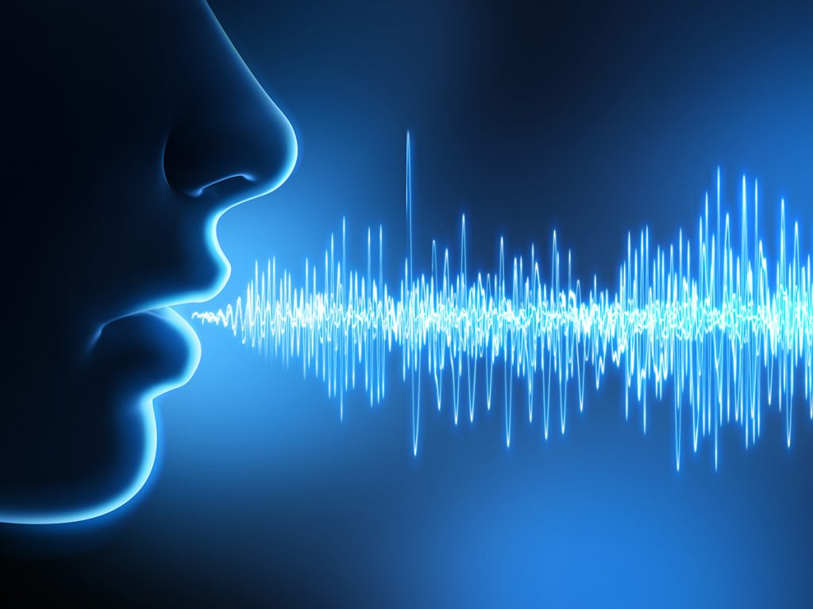
Generalization Methods
Dropping sharply at performance when dealing with out-of-domain dataset in real-life scenarios → The problem of generalization ability of audio deepfake detection system, Improving generalization ability and robustness of detection models is important
Loss Function : Improving the generalization ability of audio deepfake system to unknown attacks
Chen et al, Using LMCL(Large Margin Cosine Loss Function) and online frequency masking augmentation
Zhang et al, Using one-class learning, constructing a compact representation and utilize an angular margin without any data augmentation
Ding et al, Proposing SAMO(Speaker Attractor Multicenter One-class learning) due to the diversity of speakers
Continual Learning : Continuous training and adaptation of models on new information, aiming to overcome catastrophic forgetting existing in fine-tuning
Ma et al, DFWF(Detecting Fake Without Fogetting), not accessing old data
Zhang et al, RAWM(Regularized Adaptive Weight Modification), relaxing the regularized constrain in DFWF
When the pre-trained model is fine-tuned with anti-spoofing data, a simple neural network with an average temporal pooling and linear layer is sufficient : Potential direction to improve the generalization of fake audio detection

Slide 11
Future Directions
Prevention : Blockchains and distributed ledger technologies(DLTs), uses of perceived emotions
Mitigation : Keeping some detection tools proprietary only to people who need it like fact checkers for reporters, Make researchers who work on extending deepfake generation frameworks, propose a strong method for detecting the deepfakes generated by their framework
Detection : Working on the features which are fed into the network, “generalization” by changing or improving both of the networks and features as well as defining different loss functions, input variables(MFCCs, vocal tract, layer-wise neuron activation patterns-needs special pre-processing)
Other issues
Collecting audio datasets in the wild
Designing large-scale multilingual datasets
Improving the interpretability of detection results, e.g. Audio Forensic
Exploring more reasonable evaluation metrics

Slide 12
Conclusions
Necessity of awareness of deepfakes and the harm and questioning what we see and hear online since the content can be misleading
Needs to be done more research in the field of audio deepfakes
Proposing robust and general algorithms with valid and reliable samples in order to make the detection of deepfake audio applicable to real situations

Slide 13
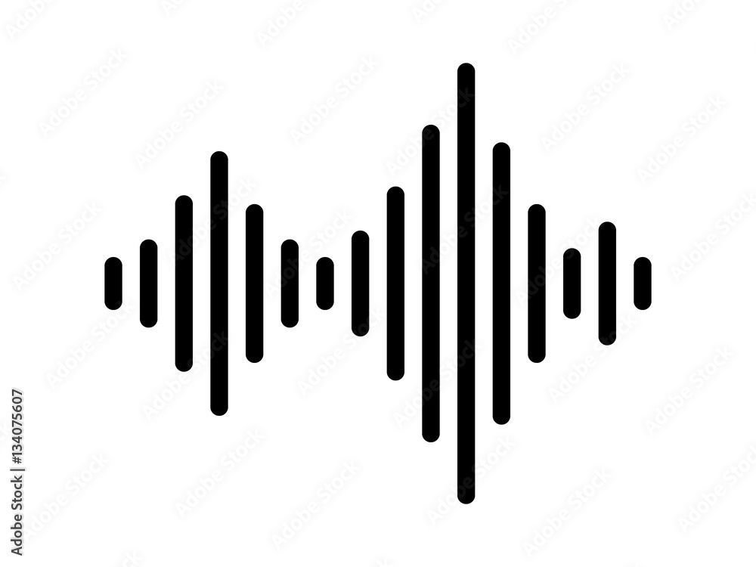
Q & A

